Slide 1
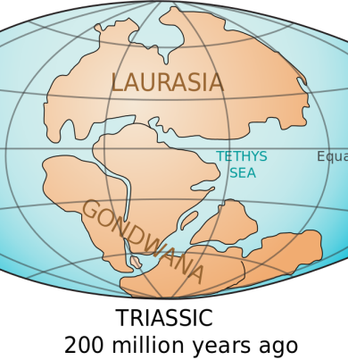
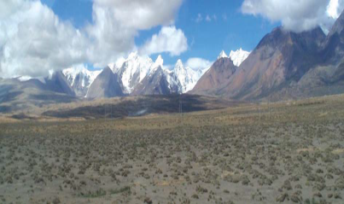
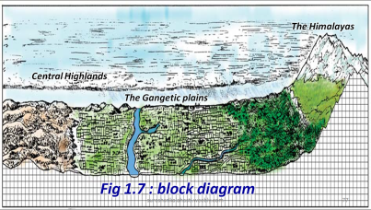
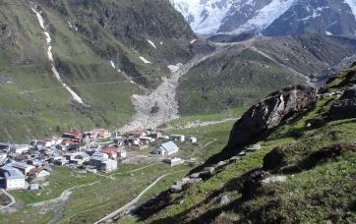
CHAPTER 1
INDIA - RELIEF FEATURES
BITS & IMPORTANT POINTS
1. For India the central longitude 82.3° E is taken as Standard Meridian.
2. 82.3° E longitude passes near Allahabad and Kakinada.
3. IST means Indian Standard Time.
4. GMT means Greenwich Mean Time.
5. The time difference between GMT and IST is 5 ½ hours.
6. India has an extension of 2,933 kms from East to West.
7. India has an extension of 3,214 kms from North to south.
8. The country's mainland lies between 8°4' and 37°6' north latitudes.
9. India has the land frontier of 15,200 kms and a coastal line of 7,516 kms.
10. India lies entirely in the Northern Hemisphere.
11. Indian sub-continent includes India, Pakistan, Bangladesh, Nepal, Bhutan, Sri Lanka and Maldives.
12. World land forms originated from two giant lands namely Angara land
(Laurasia) and Gondwana land.
13. The Indian peninsula was part of Gondwana land.
14. Over 200 million years ago Gondwana land split into pieces.
15. Indian plate moved towards north-west and collided the much larger
Eurasian Plate(Angara land).
16. The Himalayan ranges west to east distance is 2400 kms.
17. The Himalayan ranges width is 200 to 500 kms.
18. The Himalayas comprise three parallel ranges. 1. Himadri 2. Himachal/
Lesser Himalayas 3. Shivaliks.
19. The northern most range is known as Greater Himalayas or Himadri.
20. Greater Himalayas is continuous with the highest peaks.
21. Greater Himalayas average height 6100 mts.
22. Lesser Himalayas average height 3,700 to 4,500 mts.
23. Pir panjal and Mahabharata ranges are in the part of Lesser Himalayas.
24. Valley of Kashmir, the Kangra and Kulu are in Lesser Himalayas.
25. Simla, Mussorie, Nainital, Raniket Hill stations are in Lesser Himalayas.
26. Lesser Himalayas covered by evergreen forest.
27. Shivaliks width is 10-50 kms.
28. Shivaliks average height is 900 - 1100 mts.
29. Shivaliks are called as Jammu hills in Jammu region.
30. Shivaliks are called as Mishmi hills in Arunachal Pradesh.
31. Shivaliks are called as Cachar hills in Assam.
32. Shivaliks consist of thick gravel and alluvium.
33. The valleys lying between the Himachal and Shivalik are called Duns.
34. The prominent Duns are Dehradun, Kotli Dun and Patli Dun.
35. The eastern most boundary of the Himalayas is the Brahmaputra valley.
36. Purvanchal are known as Patkai, Naga, Manipuri, Khasi and Mizo hills.
37. The Himalayas are reason for summer rains and monsoon climate.
38. River Indus tributaries :1. Jhelum2. Chenab 3. Ravi 4. Beas 5. Sutlej.
39. The Himalayan Rivers have a perennial flow.
40. The Himalayan Rivers are fed by the glaciers.
41. ‘Doab’ means two rivers.
42. Ganga plain extends from the rivers Ghaggar to Teesta.
43. Gravel and pebble sediments feature is known as ‘Bhabar’.
44. Swampy and marshy region called Terai.
45. India is surrounded by the sea on three sides.
46. The Indian plateau is mainly composed of the old crystalline,
hard igneous and metamorphic rock.
47. The Indian plateau is slightly tilted towards east.
2,933 KMS
3,214 KMS
INDIA EXTENSION MAP
DUN
CHENAB
RAVI
JELUM
BEAS
INDUS
SUTLEJ
INDUS TRIBUTARIES

Slide 2
48. The peninsular plateau consists of two divisions namely, the Malwa plateau (central high lands) and the Deccan Plateau.
49. The famous hill station Udagamandalam, popularly known as Ooty.
50. The Mahadev range forms the Deccan plateau’s eastern edge.
51. Western Ghats, Eastern Ghats and Nilgiris form western, eastern and southern boundaries to the Deccan plateau.
52. Anaimudi 2695 mts (Annamalai hills) is the highest peak in south India.
53. Western Ghats include the Anaimalai, Palani (Tamilnadu) and Cardamom (Kerala) hills.
54. In comparison to the Gangetic plains the plateau region is dry.
55. The highest peak in Eastern Ghats is found at Chinthapalli (1680 mts).
56. Nallamalas, Velikondas, Palakondas and Seshachala are the tracts of Eastern Ghats.
57. The Eastern Ghats extends from Mahanadi valley to Nilgiris.
58. The southernmost tip of the plateau is Kanyakumari.
59. Chhotanagpur plateau is rich in mineral resources.
60. The Deccan plateau is a triangular landmass.
61. Satpura range forms the Deccan plateau’s north edge.
62. The Western Ghats lie parallel to the west coast.
63. The Western Ghats are higher than the Eastern Ghats.
64. Western Ghats extend for 1600 kms.
65. Western Ghats height 2000 mts.
66. Near Gudalur the Nilgiris joins the Western Ghats.
67. Ooty is located in Nilgiris.
68. Dodda Betta (2637 mts) is the highest peak in Nilgiris.
69. The average height of the Eastern Ghats 900 mts.
Malwa plateau
MAHADEV RANGE
Chinthapalli
Palakondas
Velikondas
Nallamalas
Seshachala
Gudalur
Dodda Betta
Ooty
Palani
Anaimudi
70. The Deccan plateau is formed with black soils due to volcanic activity.
71. The Thar Desert is located on the leeward side of Aravalies.
72. The Thar Desert receives rainfall 100 to 150 mm per year.
73. The Thar Desert has an arid climate with very low vegetation cover.
74. ‘Luni’ is the only river in the Thar Desert.
75. Indira Gandhi canal is the longest canal in the country (650kms).
76. The western coast starts at Rann of Kutch and ends at Kanyakumari.
77. The western coast is narrower than the east coast.
78. Maharashtra and Goa coast is called as Konkan Coast.
79. Karnataka coast is called as Canara coast.
80. Kerala coast is called as Malabar coast.
81. The western coast starts from Mahanadi to Cauvery.
82. Odisha coast is called as Utkal coast.
83. Andhra Pradesh coast is called as Sircar coast.
84. Tamil Nadu coast is called as Coramandal coast.
85. Lake Chilka is in Odisha.
86. Lake Kolleru and Pulicat are in Andhra Pradesh.
87. Andaman and Nicobar Islands stretched in Bay of Bengal.
88. Lakshadweep Islands are in the Arabian Sea.
89. In Andaman and Nicobar, Narkondam and Barren are volcanic origin.
90. The southernmost tip of India is found in Nicobar called as Indira point.
91. Indira point was submerged during the 2004 Tsunami.
92. Lakshadweep Islands are of coral origin.
93. Lakshadweep Islands total geographic area is 32 sq.kms.
94. Lakshadweep Island is famous for great variety of flora and fauna.
KONKAN
UTKAL
CANARA
SIRCAR
MALABAR
CORAMANDAL
FAUNA

Slide 3
1. The sun rises two hours earlier in Arunachal Pradesh as compared to Gujarat in the west. But the watches show the same time. How does this happen?
A. 1. Arunachal Pradesh is in the eastern most part of India.
2. Gujarat is in the Western most part of India.
3. The East West maximum distance of India is 3,000 km.
4. The time difference between Arunachal Pradesh & Gujarat is 2 hours.
5. To remove the time differences, the time is decided on a central meridian.
6. That is called Standard Meridian.
7. The time at 82½° east longitude is taken as Indian Standard Time.
8. Because of this reason, all the watches show the same time.
2. If the Himalayas would have not been in its present
position how would be the climatic conditions of
the Indian sub continent?
A. 1. The Himalayas protect India from the cold-winds of central
Asia during winter.
2. The Himalayas are responsible for causing rainfall. 3. Himalayas are the birth places of the great perennial rivers, Indus, Ganga and Brahmaputra.
4. No tropical monsoon climate in India.
5. They intercept the summer monsoons coming from the ocean.
6. Without Himalayas India would have been a desert.
3. The Himalayas do not extend into which of the
following states: Madhya Pradesh, Uttar Pradesh,
Sikkim, Haryana, Punjab, Uttaranchal
A. The Himalayas do not extend into the following states:
1. Madhya Pradesh 2. Uttar Pradesh
3. Punjab 4. Haryana
4. Which are the major physiographic divisions of
India? Contrast the relief of the Himalayan region
with that of the peninsular plateau.
A. The relief divisions of Indian landmass can be divided into the
following groups
1. The Himalayas 2. The Indo-Gangetic Plain
3. The Peninsular Plateau 4. The Coastal plains
5. The Desert 6. The Islands.
Arunachal Pradesh
Gujarat
82½° east longitude
HIMALAYAS EXTENDED STATES IN INDIA
Contrast in the relief of Himalayan region with that of peninsular plateau.
THE HIMALAYAN REGION | THE PENINSULAR PLATEAU REGION
1. The Himalayan Region is the northern border of India. | 1. The peninsular plateau Region is surrounded by the ghats and hills.
2. The highest mountain ranges of the world. | 2. A portion of Gondwana land mass.
3. Formed by sedimentary rocks | 3. Formed by Igneous and metamorphic rocks
4. This region run in the east-west direction | 4. This region tilted towards east.
5. The rivers in this region are perennial rivers | 5. The rivers in this region are not perennial.
6. Karakorum, western and Eastern Himalayas and Purvanchal ranges are found here | 6. Vindya, Satpura, western and Eastern Ghats Nilgiri hills are found here.
7. Everest, K2, Kanchenjunga are Major Mountain peaks of this region | 7. Anaimudi, Dodabetta, are the important peaks of this region
8. These are parallel ranges. | 8. The plateau has been dissected by rivers
9. It has three parallel ranges. They are 1. Himadri. 2. Himachal. 3. Siwalik | 9. It has two divisions. They are 1. The central high lands 2. T he Deccan plateau.

Slide 4
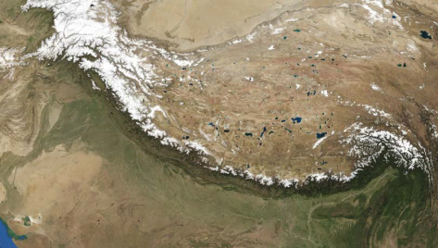
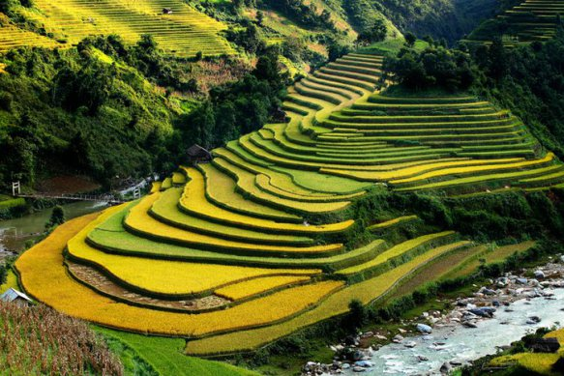
5. What is the influence of the Himalayas on Indian agriculture?
A. 1. Agriculture is the backbone of Indian Economy.
2. The agricultural land around Himalayan rivers are very fertile.
3. Major rivers have enough water for irrigation.
4. The great rivers carry alluvium from the Himalayas.
5. This is deposited in the Great Plain of North India in the
form of fertile lands.
6. It is agriculturally the most productive part of the country.
6. The Himalayan slopes offer terraced cultivation.
7. Rice is the main crop on the terraced slopes.
8. The other crops are wheat, maize, potatoes, tobacco and ginger.
9. Tea is a unique crop which can be grown on the hill slopes only.
10. A wide variety of fruits such as apples, pears, grapes, mulberry, walnut, cherries, peaches, apricot, etc. are also grown in the Himalayan region.
11. Hence, Himalayas always support the Indian agriculture.
6. Indo- Gangetic plains have high density of population. Find the reasons.
A. 1. Indo- Gangetic area is fertile and excellent for farming.
2. It makes heaven for farmers to grow rice and wheat.
3. It supports high density of population.
4. All are available with in the area.
5. So, it does not need to travel far.
6. The area is already developed.
7. It comforts more people to get work or live.
8. Therefore the Indo- Gangetic plains resulting in
high density of population.
7. How are the Eastern coastal plains and western coastal plains similar or different .
The East Coastal plain: 1. It is located between the Eastern ghats and the Bay of Bengal. 2. It extends from West Bengal to Kanyakumari. 3. It is divided into Bengal, Utkal, Circar and Coromandal coasts. 4. It is wider and flat. 5. It has deltas, formed by the rivers Mahanadi, Godavari, Krishna. 6. The East coastal plain is famous for food crops. 7. There are lakes like Chilka, Kolleru and Pulicat. 9. More irrigation facilities are in this plain. The West Coastal plain: 1. It is located between the Western Ghats and the Arabian Sea. 2. It extends from Rann of Kutch to Kanyakumari. 3. It is divided into Gujarat, Konkan, Kanara and Malabar coasts. 4. It is narrow and uneven. 5. There are no deltas. 6. The West coastal plain is famous for cash crops. 7. The plain has no lakes but it has lagoons and back waters. 9. There are no irrigation facilities in this plain.
THE HIMALAYAS
TERRACED SLOPES
THE EAST COASTAL PLAIN
THE WEST COASTAL PLAIN

Slide 5
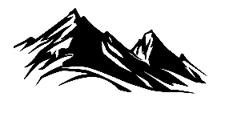
8. On an outline map of India show the following:
A. (i) Mountain and hill ranges – the Karakoram, the Zanskar, the Patkai Bum, the Jaintia, the Vindhya range, the Aravali, and the Cardamom hills.
(ii) Peaks – K2, Kanchenjunga, Nanga Parbat and the Anaimudi.
(iii)Plateaus - Chhotanagpur and Malwa.
( iv)The Indian Desert, Western Ghats, Lakshadweep Islands.
MT. K2
NANGA PARBAT
KARAKORAM RANGE
INDIA HILLRANGES, PEAKS, PLATEAUS AND THAR DESERT
ZANSKAR RANGE
THE INDIAN DESERT
ARAVALI
KANCHENJUNGA
PATKAI BUM RANGE
INDO GANGETIC PLAINS
MALWA PLATEAU
JAINTIA
CHOTA NAGPUR PLATEAU
VINDHYA MOUNTAINS
WESTERN GHATS
LAKSHADWEEP ISLANDS
MT. ANAIMUDI
CARDAMOM HILLS
9. Plateau regions in India do not support agriculture as much as the plain regions –
what are the reasons for this?
1. A plain is a low lying land with leveled surface. 2. A plateau is an area of fairly level high ground to the surrounding area.
3. The plains are most suitable for human occupation.
4. The plains have fertile lands that are drained by rivers.
5. Large part of agricultural activity is done on the fertile plains. 6. The plateaus are mainly rich in mineral deposits. 7. The plateaus are covered by thin, light-textured soils.
8. The plateaus quickly suffer from drought.
9. That’s why Plateau regions in India do not support agriculture as much as the plain regions.
PLATEAUS IN INDIA
Malwa Plateau
Chota Nagapur Plateau
Deccan Plateau

Slide 6
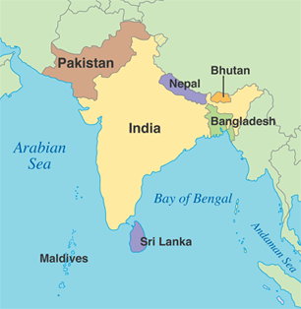
10. Use an atlas and identify the following:
(i) The Islands formed due to Volcanic eruption.
1. Narcondam
2. Barren
(ii) The countries constituting Indian Subcontinent.
1. India
2. Pakistan
3. Bangladesh
4. Nepal
5. Bhutan
6. Sri Lanka
7. Maldives
(iii) The states through which the Tropic of Cancer passes.
1. Gujarat.
2. Rajasthan.
3. Madhya Pradesh.
4. Chhattisgarh.
5. Jharkhand.
6. West Bengal.
7. Tripura.
8. Mizoram.
(iv) The northernmost latitude in degrees - 37°6' North latitude
(v) The southernmost latitude of the Indian mainland in degrees.
A. The southernmost latitude of the Indian mainland is 8°4' N.
(vi) The eastern and the western most longitude in degrees.
A 1. The eastern most longitude is 97°25'
2. The western most longitude is 68°7’
(vii) The place situated on the three seas.
1. Kanyakumari is the place which is situated on the three seas.
2. They are i. Arabian sea ii. Indian Ocean and iii. Bay of Bengal
(viii)The strait separating Sri Lanka from India.
The Palk Strait separating Sri Lanka from India.
(ix) The Union Territories of India.
Union territories -Capital 1. Delhi -Delhi 2. Andaman & Nicobar (largest UT) -Port Blair 3. Chandigarh -Chandigarh 4. Dadra, Nagar Haveli -Silvassa 5. Daman, Diu -Daman 6. Lakshadweep (smallest UT) -Kavaratti 7. Pondicherry - Pondicherry
Indian Ocean
37°6' North latitude
2
5
68°7‘ East longitude
97°25' East longitude
1
3
4
6
7
8
Tropic of Cancer
Kanyakumari
8°4' North latitude
Palk Strait

Slide 7
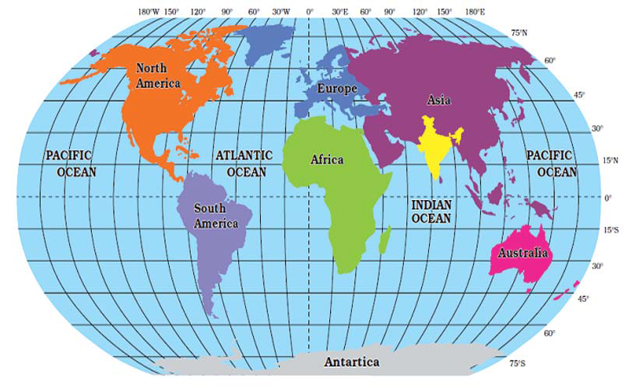
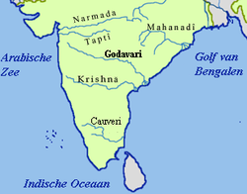
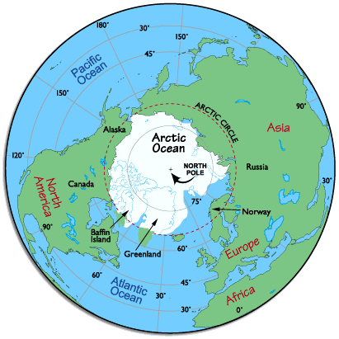
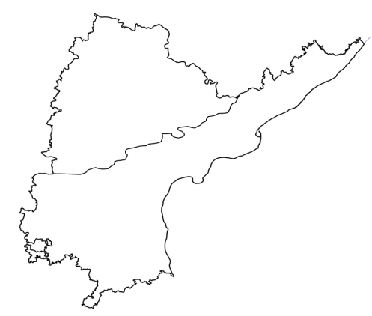
Text Book Questions page No. 1
Q. Look at the world map above, and write a few lines about India’s location with reference to the places marked on this map.
1. India is situated in the continent of Asia.
2. India is situated in Northern and eastern hemispheres.
3. India is surrounded three sides by water.
4. Tropic of Cancer 23 ½ ° North latitude goes across our country.
Q. The lines of latitude and longitude are used for accurately specifying location of any place or region. Use the atlas and correct the following statement:
“India is a very extensive country and lies totally in the southern Hemisphere of the globe. The country’s mainland lies between 8 degree N and 50 degree N longitude and 68 degree S and 9 degree E latitude.”
A. “India is a very extensive country and lies totally in the northern Hemisphere of the globe. The country’s mainland lies between 8°4' N and 37°6' N latitude and 68°7' E and 97°25' E longitude.”
37°6' North latitude
68°7' East longitude
97°25' East longitude
Text Book Questions page No. 2
Q. Why do we often use the term “Indian peninsula”?
A. 1. Peninsula means a piece of land three sides surrounded by water.
2. India is surrounded by the sea on three sides.
3. In the east Bay of Bengal, in the west Arabian sea and in the south Indian Ocean.
4. That’s why we often use the term “Indian peninsula”
Q. Examine the map 1.1 above and imagine that India is located in the Arctic Circle. How would your life be different?
A. If India located in the Arctic Circle our lifestyle would be like this:
i. India would be totally covered with ice.
ii. There would be no crops in India.
iii. Reindeer, seal, walrus and penguin would find here.
iv. Due to cold climate, population would be very low.
v. There would be no developed cities like Delhi, Mumbai and Chennai.
vi. In our life there would be no transport, rivers and lakes.
vii. Our food habits, lifestyle and culture may be different.
Q. Identify Indira point on the atlas. What is special
about this?
A. 1. Indira Point is the southern-most point of Republic of India.
2. It is situated in the Great Nicobar.
3. It was formerly known as Pygmalion Point.
4. It was renamed in honor of former Prime Minister
Indira Gandhi on 22-11-1985.
5. It was submerged during the 2004 Tsunami.
Q. Andhra Pradesh lies between …… and ……
N latitudes, and …… and ….. E longitudes.
A. 1. Andhra Pradesh lies between 12°N and 22°N latitude.
2. Andhra Pradesh lies between 77° E and 84° E longitude.
8°4' North latitude
Indian peninsula
22°NORTH LATITUDE
77° EAST LONGITUDE
84° EAST LONGITUDE
12° NORTH LATITUDE

Slide 8
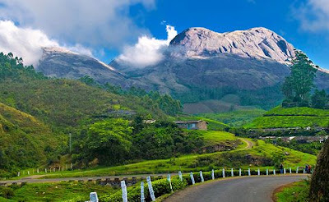
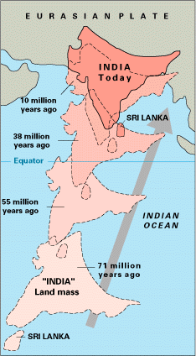
Q. Using the scale given in your atlas estimate the length of the coast line for Andhra Pradesh?
A. Using the scale given in the atlas I estimat the length of the coast line for Andhra Pradesh, that is 972 K.M.
Q. Look at the map .1.2 Trace the boundary for India and color this. With the help of the scale given on the map, find out the total land boundary that India shares with Bangladesh.
A. 1. The boundary for India in the given map is 24.5 cms.
2. Scale of the map is 1cm = 200 kms.
3. Total land boundary that India shares with Bangladesh is 4906 kms.
Q. Which of these data are for rising and setting times for the Sun at Ahmedabad and Imphal. Explain your reason
A.
Reason:-
1. Imphal ( 93⁰ E) is located to the east of Ahmedabad ( 72⁰ E) .
2. So, Sun rises in the Imphal first.
3. Time difference between Imphal and Ahmedabad is 84 minutes.
Indira point
Date | Location _____ |  | Location ____ ?
5 Jan | Sunrise 05:59 | Sunset 16:37 | Sunrise 07:20 | Sunset 18:05
Ahmedabad
Imphal
Date | Location Imphal |  | Location Ahmedabad
5 Jan | Sunrise 05:59 | Sunset 16:37 | Sunrise 07:20 | Sunset 18:05
PURVANCHAL
Text Book Questions page No. 4
Q. List the Himalayan rivers and the Peninsular rivers that helped the formation of north Indian Plain.
A. i. Himalayan rivers that helped the formation of north Indian Plain.
1. Ganga and its tributaries like Yamuna, Ramganga, Sarada, Kosi.
2. Indus and its tributaries like Jhelum, Chenab, ravi, beas, Sutlej.
3. Bramhaputra and its tributaries.
ii. Peninsular rivers that helped the formation of north Indian Plain.
1. Chambal
2. Betwa
3. Son
Q. The formation of Himalayas was ____ million years ago while early hunter - gathering human beings emerged on earth ____ million years ago.
A. 1. The formation of Himalayas was 200 million years ago
2. Hunter-gatherers emerged on earth 1.8 million years ago.

Slide 9
Text Book Questions page No. 5
Q. Look at the fig 1.2 and the raised relief map in your school. Using your finger trace the regions mentioned below:
Follow the course of Godavari and Krishna to identify the direction of slope of Deccan plateau.
A. The direction of slope of Deccan plateau is slightly tilted towards east.
Q. Describe the entire course of the Brahmaputra River, with reference to landforms, heights, and countries.
A. 1. The eastern most boundary of the Himalayas is the Brahmaputra valley.
2. In Arunachal Pradesh beyond the Dihang valley, the Himalayas takes hair pin bend.
3. The Brahmaputra River acts as eastern boundary of India
4. It runs through the north eastern states.
5. These divisions are known as ‘Purvanchal’.
6. Purvanchal mostly composed of sedimentary sand stones.
7. Regionally the Purvanchal are known as Patkai, the Naga, Manipuri, Khasi and Mizo hills.
GODAVARI
KRISHNA
COURSE OF KRISHNA & GODAVARI
TSANGPO
THE SIANG
THE DIHANG
COURSE OF BRAMHAPUTRA
Himachal
Q. Locate the three ranges in your atlas.
A. 1. Himadri / Greater Himalayas
2. Himachal / lesser Himalayas
3. Shivaliks.
Himadri
Siwalik
THREE RANGES IN HIMALAYAS
Nanga Parbat
Mt. K2
Nanda Devi
Q. Locate some of the highest peaks in the raised relief map.
1. Mt. Everest (8848 mts) 2. Mt. K2 (8611 mts.) 3. Kanchenjunga (8586mts) 4. Dhaulagiri (8167mts) 5. Nanga Parbat (8126mts.) 6. Annapurna (8091mts) 7. Nanda Devi (7816mts)
Mt. Dhaulagiri
Mt. Annapurna
Mt. Everest
Kanchenjunga
HIGHEST PEAKS IN HIMALAYAS
Q. Trace with your finger on the above regions in the raised relief map and on the wall map.
A. Dear students do this activity with a wall map.
Q. Locate the following places on Indian physical map in your atlas: Simla, Mussorie, Nainital and Raniket
A.
SIMLA
MUSSORIE
RANIKET
NAINITAL
1
2
3
4

Slide 10
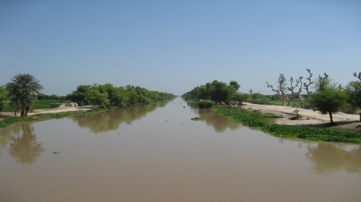
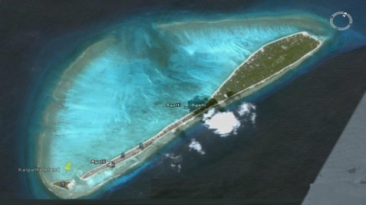
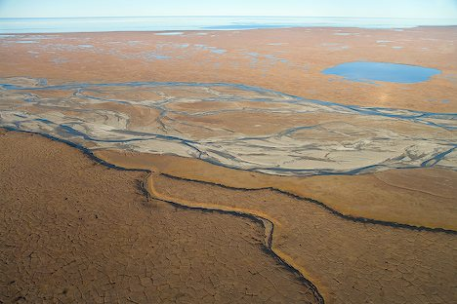
Text Book Questions page No. 7
Locate the following ranges in Indian physical map of your Atlas
A.
Hills | State/ states
Purvanchal hills | Assom, Manipur Nagaland Mizoram
Patkai hills | Assom Nagaland
Naga hills | Nagaland
Manipuri hills | Manipur
PATKAI HILLS
PURVANCHAL
NAGA HILLS
MANIPURI HILLS
MIZO HILLS
NORTH-EASTERN INDIA MAP
Text Book Questions page No. 9
Q. Locate the following on the Indian physical map of your atlas and on the raised relief map:
Malwa plateau, Bundelkhand, Bhagelkhand, Rajamahal Hills and Chhotanagpur plateau Using an atlas compare the relative heights of above plateau with that of Tibetan plateau
PERENNIAL CANAL
INDIAN PHYSICAL MAP
TIBETAN PLATEAU
CORAL REEFS
BUNDELKHAND
BHAGELKHAND
RAJMAHAL HILLS
MALWA PLATEAU
COSTAL PLAINS
CHOTA NAGAPUR PLATEAU
GHATS
A. 1. Height of the Tibetan plateau - 4,500 mts.
2. Height of the Malwa Plateau – 600 mts.
3. Height of the Bundelkhand - 500mts
4. Height of the Bhagelkhand – 500mts
5. Height of the Rajmahal Hills – 200–300 m
6. Height of the Chota Nagapur Plateau - 1,350 m
6. Among these. Tibetan plateau is the highest plateau.
WESTERN GHATS
EASTERN

Slide 11
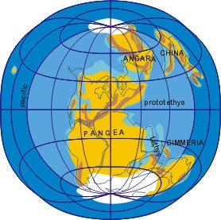
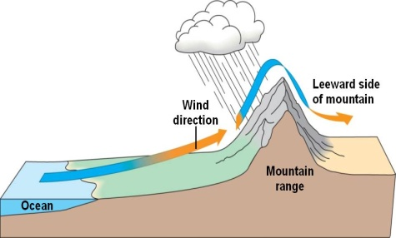
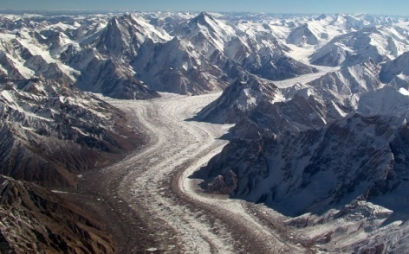
Text Book Questions page No. 10
Q. Look at the raised relief map and compare the relative heights Western and Eastern Ghats as well as Tibetan plateau and Himalayan peaks.
A. 1. The average height of Western Ghats is 2,695 m
2. The average height of Eastern Ghats is 1,680 m
3. Western Ghats have more height than eastern Ghats.
4. The height of Tibetan plateau is more than 4,500 mts
5. The height of Himalayan peaks are more than 6100 mts.
GHATS
WESTERN GHATS
EASTERN
Text Book Questions page No. 12
Q. On the physical map of India identify the delta regions. How is their height similar or different? How do they compare in relation to the northern plains?
A. 1. In India we have many deltas.
2. For example Ganga delta, Godavari delta, Krishna Delta.
3. Deltas are formed at the mouth of the rivers.
4. Plains are formed through the erosion of the land by the rivers.
5. Deltas height is equal to the sea level.
6. Where as plains height is high than deltas.
Ganga Delta
Mahanadi delta
Godavari delta
Krishna delta
Penna delta
ANGARA LAND
KEY WORDS
1. Perennial :- Flowing throughout the year.
2. Coral reefs:- Coral reefs are underwater structures made
from calcium carbonate secreted by corals.
3. Costal plains :- Coastal plains are the area of flat, low-lying
land adjacent to a seacoast.
4. Peninsula :- Peninsula means a piece of land three sides
surrounded by water.
5. Laurasia :- Ancient continental mass in the Northern Hemisphere that included North America, Europe, and Asia (except peninsular India).
6. Dun :- A narrow longitudinal flat-bottomed strike valley.
7. Angara land :- Ancient continental mass consisted of modern continents of Asia and Europe.
8. Gondwana land :- Ancient continental mass consisted present-day South America, Africa, Arabia, Madagascar, India, Australia, and Antarctica.
9. Shivalik :- A mountain range of the outer Himalayas.
10. Purvanchal :- A geographic region of north-central India,
which comprises the eastern end of Uttar Pradesh state.
11. Leeward :- Towards the side sheltered from the wind.
12. Glaciers:- A huge mass of ice slowly flowing over a land mass.
LEEWARD
GLACIERS

